Slide 1







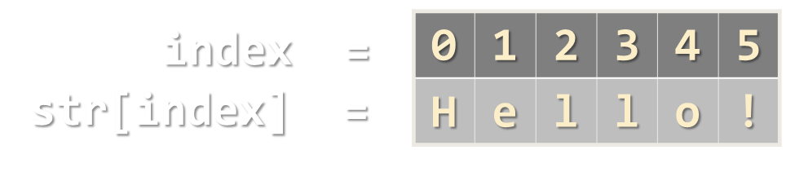
Strings and Regular Expressions
Strings, String Operations, Regular Expressions, Match, Split, Replace
Strings and RegExp
SoftUni Team
Technical Trainers
Software University
http://softuni.bg

Slide 2



Table of Contents
Strings in JavaScript
String Operations
Search, Substring, Trim, Replace, Delete, Split
HTML Escaping
Regular Expressions
Validate, Find Matches, Groups, Split, Replace

Slide 3
Have a Question?
sli.do #JSCORE

Slide 4
Strings in JavaScript

Slide 5
Strings in JavaScript
Strings in JS hold a sequence of Unicode characters
Immutable by design → cannot be changed
Like arrays have length and provide access by index []
let str1 = "Text in double quotes";
let str2 = 'Text in single quotes';
let str = str1 + ' ' + str2;
for (let i = 0; i < str.length; i++)
console.log(`${i} -> ${str[i]}`);

Slide 6
Problem: Print String Letters
Read a string and print its letters as shown below
SoftUni
function printStringLetters(str) {
for (let i in str)
console.log(
`str[${i}] -> ${str[i]}`);
}
str[0] -> S
str[1] -> o
str[2] -> f
str[3] -> t
str[4] -> U
str[5] -> n
str[6] -> i
printStringLetters('Hello');
printStringLetters(['SoftUni']);
Check your solution here: https://judge.softuni.bg/Contests/312

Slide 7
Problem: Concatenate and Reverse Strings
Read an array of strings, concatenate them and reverse them
I
am
student
function concatenateAndReverse(arr) {
let allStrings = arr.join('');
let chars = Array.from(allStrings);
let revChars = chars.reverse();
let revStr = revChars.join('');
return revStr;
}
tnedutsmaI
concatenateAndReverse(['I', 'am', 'student'])
Check your solution here: https://judge.softuni.bg/Contests/312

Slide 8




String Operations
Substring, Split, Join, IndexOf, …

Slide 9
String Operations: Index-Of / Sub-String
let str = "I am JavaScript developer";
console.log(str.indexOf("Java")); // 5
console.log(str.indexOf("java")); // -1
let str = "I am JavaScript developer";
let sub = str.substr(5); // substr(start, length)
console.log(sub); // JavaScript developer
let str = "I am JavaScript developer";
let sub = str.substring(5, 9); // startIndex, endIndex
console.log(sub); // Java

Slide 10
String Operations: Split / Replace
let str = "I like JS";
let tokens = str.split(' ');
console.log(tokens); // ["I", "like", "", "", "", "JS"]
tokens = tokens.filter(s => s!='');
console.log(tokens); // ["I", "like", "JS"]
console.log(tokens.join(' ')); // I like JS
let s = "I like JS. JS is cool";
console.log(s.replace('JS', "C#")); // I like C#. JS is cool
console.log(s.replace(/JS/g, "C#")); // I like C#. C# is cool

Slide 11
Problem: Count Occurrences
Count the number of times a string occurs in a text
the
function countStringInText(str, text) {
let count = 0;
let index = text.indexOf(str);
while (index > -1) {
count++;
index = text.indexOf(str, index + 1);
}
return count;
}
the quick brown fox jumps over the lazy dog
2
countStringInText('am', 'I am cool. Bam') // 2
Check your solution here: https://judge.softuni.bg/Contests/312

Slide 12
Problem: Extract Text from Parentheses
Extract all text snippets between parentheses
Parentheses cannot be nested
Rakiya (Bulgarian brandy) is home-made liquor (alcoholic drink). It can be made of grapes, plums or other fruits (even apples).
Bulgarian brandy,
alcoholic drink,
even apples

Slide 13
Solution: Extract Text from Parentheses
function extractTextFromParenthesis(text) {
let result = [];
let startIndex = text.indexOf('(');
let endIndex = text.indexOf(')', startIndex);
while (startIndex > -1 && endIndex > -1) {
let snippet = text.substring(startIndex + 1, endIndex);
result.push(snippet);
startIndex = text.indexOf('(', endIndex);
endIndex = text.indexOf(')', startIndex);
}
console.log(result.join(', '));
}
Check your solution here: https://judge.softuni.bg/Contests/312

Slide 14
Problem: Aggregate Table
Extract all towns and their combined incomes from a text table:
function aggregateTable(lines) {
let sum = 0;
let list = [];
for (let line of lines) {
let townData = line.split('|');
list.push(townData[1].trim());
sum += Number(townData[2].trim();
}
console.log(list.join(', ') + '\n' + sum);
}
| Sofia | 300
| Plovdiv | 500
| Varna | 200
| Yambol | 275
Sofia, Plovdiv, Varna, Yambol
1275
Check your solution here: https://judge.softuni.bg/Contests/312

Slide 15
Problem: Restaurant Bill
Write a function that prints purchased products (comma separated) and their sum from a list of products and sums (given as string array):
function printBill(input) {
let items = input.filter((x,i) => i%2==0);
let sum = input.filter((x,i) => i%2==1) .map(Number) .reduce((a,b) => a + b);
console.log(`You purchased ${items.join(', ')} for a total sum of ${sum}`);
}
printBill(['Cola','1.35', 'Pancakes', '2.88']);
Check your solution here: https://judge.softuni.bg/Contests/312

Slide 16
Problem: Extract Username by Email
You are given a list of email addresses
Write a JS program that generates usernames by combining:
Email’s alias (e.g. "someone@domain.tld" → "someone") + "." +
The first letters of email's domain words (e.g. "softuni.bg" → "sb")
peshoo@gmail.com
todor_43@mail.dir.bg
foo@bar.com
bay.ivan@users.sf.net
peshoo.gc
todor_43.mdb
foo.bc
bay.ivan.usn
Check your solution here: https://judge.softuni.bg/Contests/312

Slide 17
Solution: Extract Username by Email
function extractUsernames(inputEmails) {
let results = [];
for (let email of inputEmails) {
let [alias, domain] = email.split('@');
let username = alias + '.';
let domainParts = domain.split('.');
domainParts.forEach(p => username += p[0]);
results.push(username);
}
console.log(results.join(', '));
}
extractUsernames(['pesho@gmail.com', 'tod_or@mail.dir.bg']);
Check your solution here: https://judge.softuni.bg/Contests/312

Slide 18
Problem: Censorship
You are given a text and a list of strings that need to be censored
Write a JS program that replaces all occurrences of the banned strings with dashes of equal length
'roses are red, violets are blue',
[', violets are',
'red']
roses are ---------------- blue

Slide 19
Solution: Censorship
function censor(text, words) {
for (let current of words) {
let replaced = '-'.repeat(current.length);
while (text.indexOf(current) > -1) {
text = text.replace(current, replaced);
}
}
return text;
}
censor('I like C#, HTML, JS and PHP',
['C#', 'HTML', 'PHP'])
Check your solution here: https://judge.softuni.bg/Contests/312

Slide 20

HTML Escaping
&lt;html&gt;

Slide 21
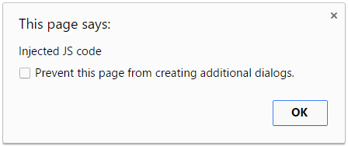
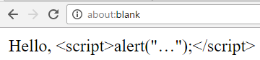
HTML Escaping
What is HTML escaping?
Replacing special characters with their escape sequence
Prevents JavaScript code injection in HTML pages
In HTML escape the following characters:
'<', '>', '&', "'" and '"'
document.write(
'Hello, <script>alert("Injected JS code")</script>');
document.write('Hello, &lt;script&gt; alert(&quot;…&quot;);&lt;/script&gt; ');

Slide 22
Implementing HTML Escaping
Just replace the special characters with their escaped sequences
htmlEscape() function can be attached to the String class:
String.prototype.htmlEscape = function() {
return this.replace(/&/g, '&amp;')
.replace(/</g, '&lt;')
.replace(/>/g, '&gt;')
.replace(/"/g, '&quot;')
.replace(/'/g, '&#39;');
}
console.log('<script>'.htmlEscape()); // &lt;script&gt;

Slide 23
Problem: Print Strings as HTML List
Write a JS function to return an array of strings as HTML list
"Hello", he said
<script>alert('hi');</script>
Use the <div> tag.
<ul> <li>&quot;Hello&quot;, he said</li>
<li>&lt;script&gt;alert(&#39;hi&#39;);&lt;/script&gt;</li>
<li>Use the &lt;div&gt; tag.</li>
</ul>

Slide 24
Solution: Print Strings as HTML List
function htmlList(items) {
return "<ul>\n" +
items.map(htmlEscape).map(
item => ` <li>${item}</li>`).join("\n") +
"</ul>\n";
function htmlEscape(text) {
let map = { '"': '&quot;', '&': '&amp;',
"'": '&#39;', '<': '&lt;', '>': '&gt;' };
return text.replace(/[\"&'<>]/g, ch => map[ch]);
}
}
document.write(htmlList(["<br>", "It's OK"]))
Check your solution here: https://judge.softuni.bg/Contests/312

Slide 25
TODO: Unescaping
TODO:
Parse a HTML table to extract first name and last name
Perform HTML unescaping for the table cell contents
<table> <tr><th>first name</th><th>last name</th></tr> <tr><th>Edsger</th><th>Dijkstra</th></tr> <tr><th>Martin &copy;</th><th>Fowler</th></tr> … </table>
Edsger Dijkstra, Martin © Fowler, …

Slide 26



Practice: JavaScript Strings
Live Exercises in Class (Lab)

Slide 27
Regular Expressions
The Beauty of Modern String Processing

Slide 28
What are Regular Expressions?
Regular expressions (regex)
Match text by pattern
Patterns are defined by special syntax, e.g.
[0-9]+ matches non-empty sequence of digits
[A-Z][a-z]* matches a capital + small letters
\s+ matches whitespace (non-empty)
\S+ matches non-whitespace
[0-9]{3,6} – matches 3-6 digits

Slide 29
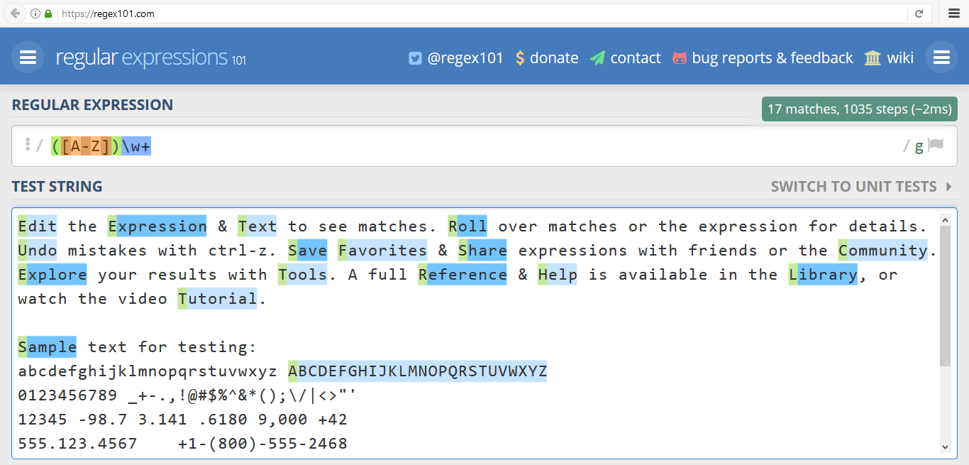
www.regex101.com
Live Demo

Slide 30
More RegExp Patterns
\d+ matches digits
\D+ matches non-digits
\w+ matches letters (Unicode)
\W+ matches non-letters
\+\d{1,3}([ -]*[0-9]){6,}
Matches international phone, e.g. +359 2 123-456

Slide 31
Validation by Regex
^ matches start of text
$ matches end of text
^\+\d{1,3}([ -]*[0-9]){6,}$
Validates international phone
+359 2 123-456 is a valid phone
+359 (888) 123-456 is a invalid phone

Slide 32
Validation by RegExp in JS
let emailPattern =
/^[a-z0-9._%+-]+@[a-z0-9.-]+\.[a-z]{2,20}$/i;
Always use ^ and $ in the regex validation patterns!
console.log(emailPattern.test("test@abv.bg"));
console.log(emailPattern.test("a.hills@gtx.de"));
console.log(emailPattern.test("invalid@@mail"));
console.log(emailPattern.test("err test@abv.bg"));

Slide 33
Problem: Email Validation
Write a JS function that performs simple email validation
An email consists of: username @ domain name
Usernames are alphanumeric
Domain names consist of two strings, separated by a period
Domain names may contain only English letters
Valid:
Invalid:
valid123@email.bg
invalid*name@emai1.bg

Slide 34
Solution: Email Validation
function validateEmail(email) {
let pattern =
/^[a-zA-Z0-9]+@[a-z]+(\.[a-z]+)+$/g;
let result = pattern.test(email);
if (result) {
console.log("Valid");
} else {
console.log("Invalid");
}
}
Returns true if the email matches the pattern
validateEmail(['bai.ivan@mail.sf.net'])
Check your solution here: https://judge.softuni.bg/Contests/312

Slide 35
Regex Literals
The classical (Perl syntax) is:
/<regex>/<options>
Examples:
/[a-z]+/gi matches all non-empty sequences of Latin letters, case-insensitively
/[a-z0-9._%+-]+@[a-z0-9.-]+\.[a-z]{2,20}/gi matches emails (simplified pattern)

Slide 36
Split by RegExp in JS
let towns =
"Sofia, Varna,Pleven, Veliko Tarnovo; Paris - London--Viena\n\n Пловдив|Каспичан";
console.log(towns.split(/\W+/)); // incorrect
console.log(towns.split(/\s*[.,|;\n\t-]+\s*/));

Slide 37
Problem: Expression Split
Write a JS function that splits a given JS code into elements
All string literals will contain only Latin letters
The code should be split on the following:
Whitespace (including tabulation)
Parentheses and control punctuation:
The output should contain no empty elements
(),;.

Slide 38
Solution: Expression Split
function expressionSplit(expression) {
let elements = expression
.split(/[\s.();,]+/);
console.log(elements.join("\n"));
}
let
sum
=
4
*
4
b
=
"wow"
expressionSplit(
'let sum = 4 * 4,b = "wow";')
Check your solution here: https://judge.softuni.bg/Contests/312

Slide 39
Find All Matches by RegExp in JS
let text = "I was born at 14-Jun-1980. Today is 29-Sep-2016. Next year starts at 1-Jan-2017 and ends at 31-Dec-2017.";
let dateRegex = /\d{1,2}-\w{3}-\d{4}/g;
console.log(text.match(dateRegex));
// ["14-Jun-1980", "29-Sep-2016", "1-Jan-2017", "31-Dec-2017"]

Slide 40
Problem: Match All Words
Extract all word char sequences from given text
_ (Underscores) are also word characters!
_|Underscores|are|also|word|characters
function matchAllWords(text) {
let words = text.match(/\w+/g);
return words.join('|');
}
matchAllWords("Hello, how are you?")
Check your solution here: https://judge.softuni.bg/Contests/312

Slide 41
Problem: Match Dates
Extract all dates from given text (array of strings)
Valid date format: dd-MMM-yyyy
Examples: 12-Jun-1999, 3-Nov-1999
I am born on 30-Dec-1994.
My father is born on the 9-Jul-1955.
01-July-2000 is not a valid date.
30-Dec-1994 (Day: 30, Month: Dec, Year: 1994)
9-Jul-1955 (Day: 9, Month: Jul, Year: 1955)

Slide 42
Solution: Match Dates (Using Groups)
function extractDates(inputSentences) {
let pattern =
/\b([0-9]{1,2})-([A-Z][a-z]{2})-([0-9]{4})\b/g;
let dates = [], match;
for (let sentence of inputSentences)
while (match = pattern.exec(sentence))
dates.push(`${match[0]} (Day: ${match[1]}, Month: ${match[2]}, Year: ${match[3]})`);
console.log(dates.join("\n"));
}
extractDates(['1-Jun-2012 is before 14-Feb-2016'])
Check your solution here: https://judge.softuni.bg/Contests/312

Slide 43
Problem: Parse Employee Data
Validate employee data and store it
Valid format is:
Names contain only letters and are capitalized
Position is alphanumeric and may hold dashes and spaces
Salary is a positive integer number
Invalid entries are ignored
name - salary - position
Name: Jonathan
Position: Manager
Salary: 2000
Name: George
Position: Team Leader
Salary: 1000
Jonathan - 2000 – Manager
Peter- 1000- Chuck
George - 1000 - Team Leader

Slide 44
Analysis: Parse Employee Data
Valid data:
Invalid data:
Employee name:
[A-Z][a-zA-Z]*
Position:
[a-zA-Z0-9 -]+
Name: Jonathan
Position: Manager
Salary: 2000
Jonathan - 2000 - Manager
Salary: [1-9][0-9]*
Peter- 1000-Chuck
No spaces around the "-"

Slide 45
Solution: Parse Employee Data
function parseEmployeeData(input) {
let regex =
/^([A-Z][a-zA-Z]*) - ([1-9][0-9]*) - ([a-zA-Z0-9 -]+)$/;
for (let element of input) {
let match = regex.exec(element);
if (match)
console.log(`Name: ${match[1]}\n` +
`Position: ${match[3]}\n` +
`Salary: ${match[2]} `);
}
}
parseEmployeeData(['Jeff - 1500 - Staff', 'Ko - 150 - Ne'])
Check your solution here: https://judge.softuni.bg/Contests/312

Slide 46
Regex Replace
String.replace() can work with regular expressions
Replace with capturing groups: $1, $2, …
let str = '<img src="[imgSource]" />';
str = str.replace(/\[imgSource\]/, './smiley.gif');
let str = 'Visit <link>http://fb.com</link> or <link>http://softuni.bg</link>.';
str = str.replace(/<link>(.*?)<\/link>/g,
'<a href="$1">Link</a>');

Slide 47
Problem: Form Filler
Write a function that replaces username, email and phone placeholders with supplied values
Username placeholder: <!{letters}!>
Email placeholder: <@{letters}@>
Phone placeholder: <+{letters}+>
The {letters} in the placeholders can hold only Latin letters
Any placeholder that does not meet these restrictions is invalid and should be left as is

Slide 48
Example: Form Filler
Pesho pesho@gmail.com 90-60-90 Hello, <!username!>! Welcome to your Personal profile. Here you can modify your profile freely. Your current username is: <!fdsfs!>. Would you like to change it? (Y/N) Your current email is: <@DasEmail@>. Would you like to change it? (Y/N) Your current phone number is: <+num+>. Would you like to change it? (Y/N)
Hello, Pesho! Welcome to your Personal profile. Here you can modify your profile freely. Your current username is: Pesho. Would you like to change it? (Y/N) Your current email is: pesho@gmail.com. Would you like to change it? (Y/N) Your current phone number is: 90-60-90. Would you like to change it? (Y/N)

Slide 49
Solution: Form Filler
function fillForm(username, email, phone, data) {
data.forEach(line => {
line = line.replace(/<![a-zA-Z]+!>/g, username);
line = line.replace(/<@[a-zA-Z]+@>/g, email);
line = line.replace(/<\+[a-zA-Z]+\+>/g, phone);
console.log(line);
});
}
fillForm('pit', 'pit@pit.com', '032746',
['I am <!user!>, my email is <@email@>, my phone is <+p+>.'])
Check your solution here: https://judge.softuni.bg/Contests/312

Slide 50
Problem: Match Multiplication
Write a JS function to multiply numbers in a text
Replace {num1} * {num2} by their product
My bill: 2*2.50 (beer); 2* 1.20 (kepab); -2 * 0.5 (deposit).
My bill: 5 (beer); 2.4 (kepab); -1 (deposit).
function performMultiplications(text) {
text = text.replace(/(-?\d+)\s*\*\s*(-?\d+(\.\d+)?)/g,
(match, num1, num2) => Number(num1) * Number(num2));
console.log(text);
}
performMultiplications('My bill: 2*2.50 (beer)')
Check your solution here: https://judge.softuni.bg/Contests/312

Slide 51
RegExp in JavaScript Recap
To create a RegExp with an object literal:
To create a RegExp with a constructor:
To get the matched text and sub groups (use in a loop):
let regex = /ab+c/ig;
let regex = new RegExp(/ab+c/, 'ig');
let regex = new RegExp('ab+c', 'ig');
regex.exec(str);
// [match, group1, group2, …]

Slide 52
RegExp in JavaScript Recap (2)
To get all matched strings (use with global flag):
To validate string (use with anchors):
Functional replace:
str.match(regex);
// [match1, match2, …]
regex.test(str); // true | false
List of groups
str.replace(regex, function);
// params: match, [p1, p2, …] offset, string

Slide 53
Practice: Regular Expressions
Live Exercises in Class (Lab)

Slide 54


Summary
String hold Unicode text
Have length and access by index []
String operations: split(), substring(), indexOf(), trim(), replace(), …
Regular expressions are very powerful
let str = "Some text";
for (let i=0; i<str.length; i++)
console.log(i + " ->" + str[i]);
console.log(/^[0-9]+$/.test("1234"))

Slide 55
Regular Expressions – Resources
Play with regular expressions:
http://www.regexr.com
https://regex101.com
Visual regex debugger:
https://www.debuggex.com
Regex explained (in Bulgarian)
http://goo.gl/NbBIPe

Slide 56
Regular Expressions – Resources (2)
JS Regex Documentation
https://developer.mozilla.org/en-US/docs/Web/JavaScript/Guide/Regular_Expression
http://w3schools.com/jsref/jsref_obj_regexp.asp
Interactive Regex Tutorial
http://regexone.com
Regex Tutorial
https://javascript.info/regular-expressions

Slide 57







Strings and Regular Expressions
https://softuni.bg/courses/

Slide 58
License
This course (slides, examples, demos, videos, homework, etc.) is licensed under the "Creative Commons Attribution-NonCommercial-ShareAlike 4.0 International" license

Slide 59





Free Trainings @ Software University
Software University Foundation – softuni.org
Software University – High-Quality Education, Profession and Job for Software Developers
softuni.bg
Software University @ Facebook
facebook.com/SoftwareUniversity
Software University Forums
forum.softuni.bg

